Slide 1
Lecture 11 Shortest Paths
Department of Computer Science
Hofstra University

Slide 2
Lecture Goals
In this lecture we study shortest-paths problems. We begin by analyzing some basic properties of shortest paths and a generic algorithm for the problem.
For single-source shortest path, we consider:
Dijkstra's algorithm
Bellman–Ford algorithm
Topological Sort for DAG
For all-pairs shortest path, we conclude:
Floyd Warshall Algorithm
Johnson’s Algorithm

Slide 3
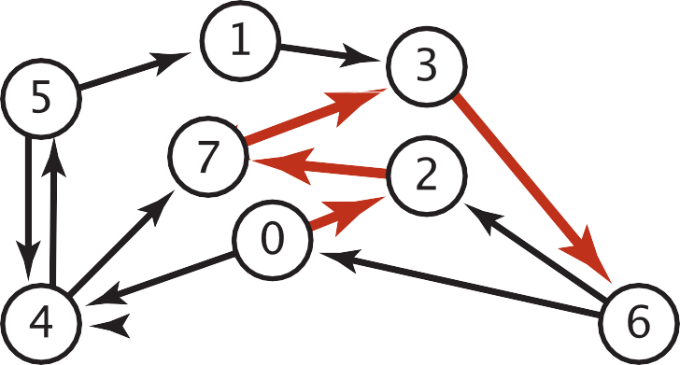
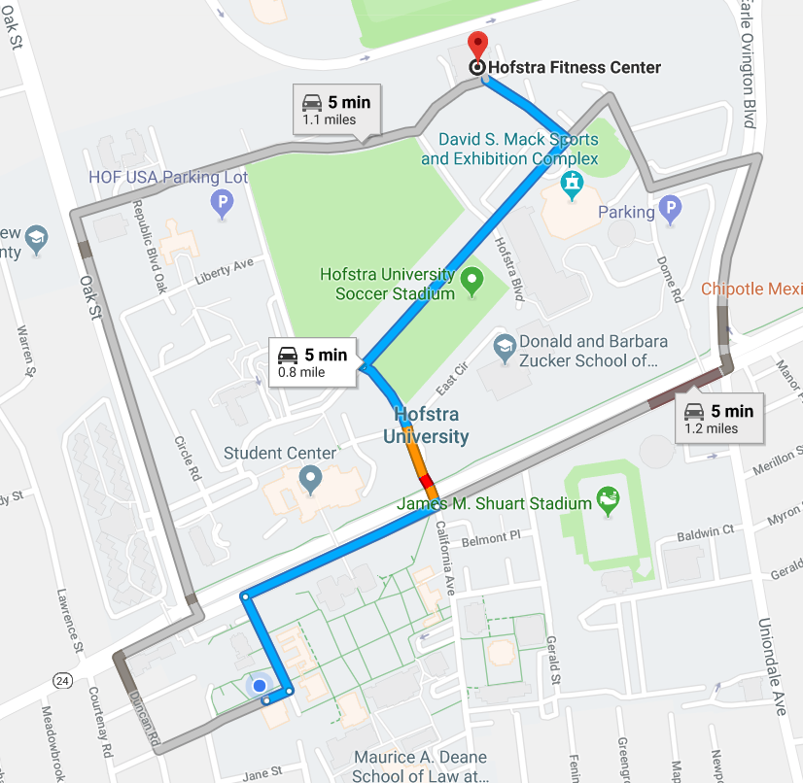

Shortest Paths in an Edge-weighted Digraph
Given an edge-weighted digraph, find the shortest path from source vertex s to t.
edge-weighted digraph
shortest path from 0 to 6
0->2 0.26
4->5 | 0.35
5->4 | 0.35
4->7 | 0.37
5->7 | 0.28
7->5 | 0.28
5->1 | 0.32
0->4 | 0.38
0->2 | 0.26
7->3 | 0.39
1->3 | 0.29
2->7 | 0.34
6->2 | 0.40
3->6 | 0.52
6->0 | 0.58
6->4 | 0.93
2->7 | 0.34
7->3 | 0.39
3->6 | 0.52
Variants
Which vertices?
Single source: from source vertex s to every other vertex.
Source-sink: from source vertex s to another t.
All pairs: between all pairs of vertices.
Nonnegative weights?
Cycles?
Negative cycles.
Simplifying assumption: Each vertex is reachable from s.

Slide 4
Shortest Paths in an Unweighted Digraph
BFS (Breadth-First Search) can find shortest paths in unweighted graphs.
BFS visits nodes in order of their distance from the source vertex, ensuring the first path found to any node is the shortest possible path in terms of the number of edges.
Time complexity: O(V+E)
Advantages:
Optimal for unweighted graphs
Simpler implementation than Dijkstra's
Limitations:
Only works for unweighted graphs
Not suitable for graphs with negative edges

Slide 5

Edge Relaxation
Relax edge e = u→v with weight w(u,v). (We also write uv to denote u→v)
distTo[u] is length of shortest known path from s to u.
distTo[v] is length of shortest known path from s to v.
prevNode[v] is the previous vertex on shortest known path from s to v.
If e = u→v gives shorter path to v through u, update distTo[v] and prevNode[v].
distTo[v] = min(distTo[v], distTo[u] + w(u,v)); prevNode[v]=u
After relaxing edge uv, the shortest path from s to v is updated to go through vertex u, with cost of 4.4
prevNode[v]=u
private void relax(DirectedEdge e)
{
Int u = e.from(), v = e.to();
if (distTo[v] > distTo[u] + w(u,v))
{
distTo[v] = distTo[u] + w(u,v);
prevNode[v] = u;
}
}
3.1
u
1.3
s
v
7.2
OLD distTo[v] = 7.2 > distTo[u] + w(u,v)
= 3.1+1.3 = 4.4
NEW distTo[v] ← distTo[u] + w(u,v) = 4.4, prevNode[v] = u
x
Previous shortest path from s to v goes through vertex x, with cost of 7.2
Notes:
Dijkstra’s Algorithm is greedy and optimal: any vertex that has been visited should have its shortest distance to the source.

Slide 6
Generic Shortest-paths Algorithm
Generic algorithm (to compute SPT from s)
For each vertex v: distTo[v] = ∞.
For each vertex v: prevNode[v] = null.
distTo[s] = 0.
Repeat until done:
- Relax any edge.
Proposition. Generic algorithm computes SPT (if it exists) from s.
Pf.
Throughout algorithm, distTo[v] is the length of a simple path from s to v (and prevNode[v] is its previous vertex on the path).
Each successful relaxation decreases distTo[v] for some v.
The entry distTo[v] can decrease at most a finite number of times.
Efficient implementations. How to choose which edge to relax?
Ex 1. Dijkstra’s algorithm. (no negative weights).
Ex 2. Bellman–Ford algorithm. (negative weights, can detect negative cycles).
Ex 3. Topological sort. (DAG with no directed cycles)
Notes:
Ex 2. Topological sort algorithm. (no directed cycles).

Slide 7
Dijkstra's Algorithm
Initialization:
Set the distance to the source vertex as 0 and to all other vertices as infinity.
Mark all vertices as unvisited and store them in a priority queue.
Main Loop:
Visit the unvisited vertex u with the shortest known distance from the queue.
For each unvisited neighbor vertex v of vertex u, calculate its tentative distance through the current vertex. If this distance is smaller than the previously recorded distance, update it with edge relaxation for edge uv.
Mark the current vertex as visited once all its neighbors are processed.
Termination:
The algorithm continues until all reachable vertices are visited.
Time complexity: O(V log V + V) for Binary Heap implementation
Notes:
Dijkstra’s Algorithm is greedy and optimal: any vertex that has been visited should have its shortest distance to the source.
It works for both undirected and directed graphs. The only difference is the function for getting the neighbors of vertex v, as each undirected edge is treated as two directed edges in opposite directions.)
Notes:
which follows the edge arrow direction for directed graphs

Slide 8
Dijkstra’s Algorithm: Correctness Proof
Proposition. Dijkstra's algorithm computes a SPT in any edge-weighted digraph with nonnegative weights.
Proof.
Each edge e = u→v is relaxed exactly once (when vertex u is visited), afterwards:
distTo[v] ≤ distTo[u] + w(u,v).
Inequality holds until algorithm terminates because:
distTo[v] cannot increase
distTo[u] will not change
Thus, upon termination, shortest-paths optimality conditions hold.
distTo[ ] values are monotone decreasing
we choose lowest distTo[ ] value at each step (and edge weights are nonnegative)

Slide 9
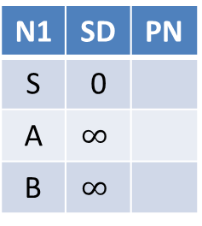
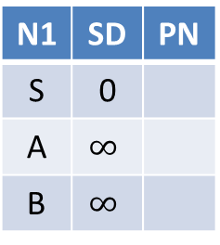
Toy Example: find shortest path starting from source vertex S for undirected graph SD: Shortest Distance. PN: Previous Node
A
2
S
1
4
B
N1 | SD | PN
S | 0
A | $$∞$$
B | $$∞$$
N1 | SD | PN
S | 0
A | 2 | S
B | 4 | S
N1 | SD | PN
S | 0
A | 2 | S
B | 3 | A
N1 | SD | PN
S | 0
A | 2 | S
B | 3 | A
Visit S
Visit A
Visit B
A
2
S
3
4
B
N1 | SD | PN
S | 0
A | $$∞$$
B | $$∞$$
N1 | SD | PN
S | 0
A | 2 | S
B | 4 | S
N1 | SD | PN
S | 0
A | 2 | S
B | 4 | S
N1 | SD | PN
S | 0
A | 2 | S
B | 4 | S
Visit S
Visit A
Visit B

Slide 10
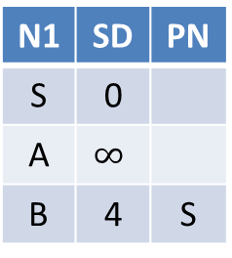
Toy Example: find shortest path starting from source vertex S for directed graph
A
2
S
1
4
B
N1 | SD | PN
S | 0
A | $$∞$$
B | $$∞$$
N1 | SD | PN
S | 0
A | 2 | S
B | 4 | S
N1 | SD | PN
S | 0
A | 2 | S
B | 4 | S
N1 | SD | PN
S | 0
A | 2 | S
B | 4 | S
Visit S
Visit A
Visit B
A
2
S
1
4
B
N1 | SD | PN
S | 0
A | $$∞$$
B | $$∞$$
N1 | SD | PN
S | 0
A | $$∞$$
B | 4 | S
N1 | SD | PN
S | 0
A | 5 | B
B | 4 | S
N1 | SD | PN
S | 0
A | 5 | B
B | 4 | S
Visit S
Visit B
Visit A

Slide 11
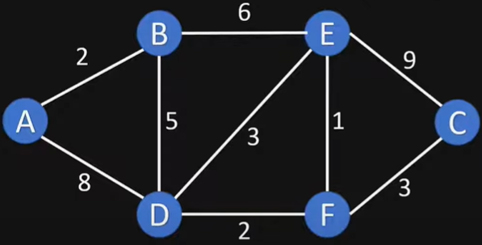
Example Graph

Slide 12
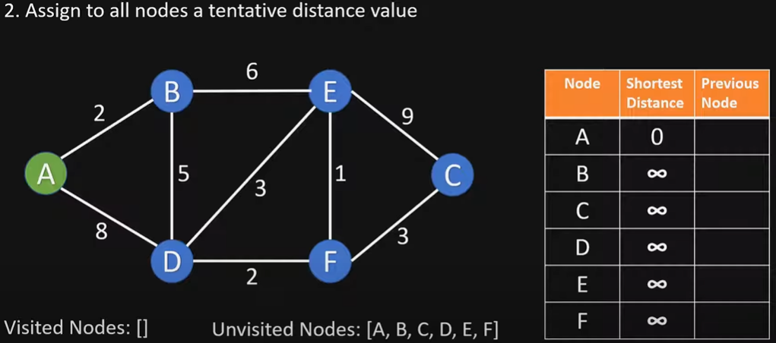
Initialize

Slide 13
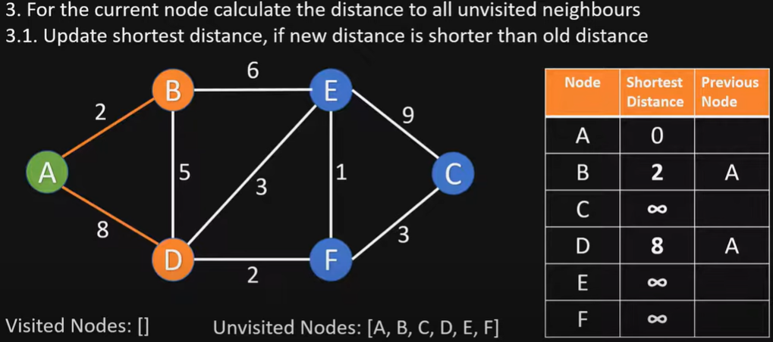
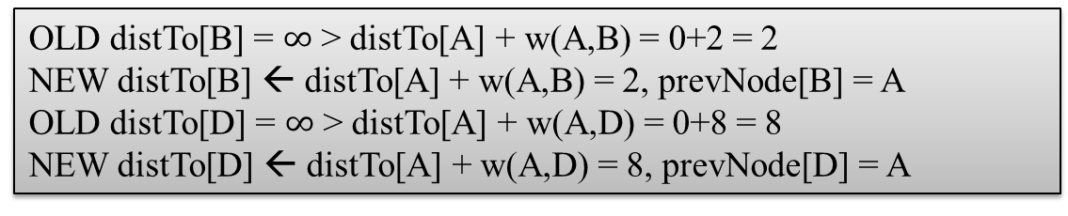
Visit vertex A
OLD distTo[B] = $∞$ > distTo[A] + w(A,B) = 0+2 = 2
NEW distTo[B] ← distTo[A] + w(A,B) = 2, prevNode[B] = A
OLD distTo[D] = $∞$ > distTo[A] + w(A,D) = 0+8 = 8
NEW distTo[D] ← distTo[A] + w(A,D) = 8, prevNode[D] = A

Slide 14
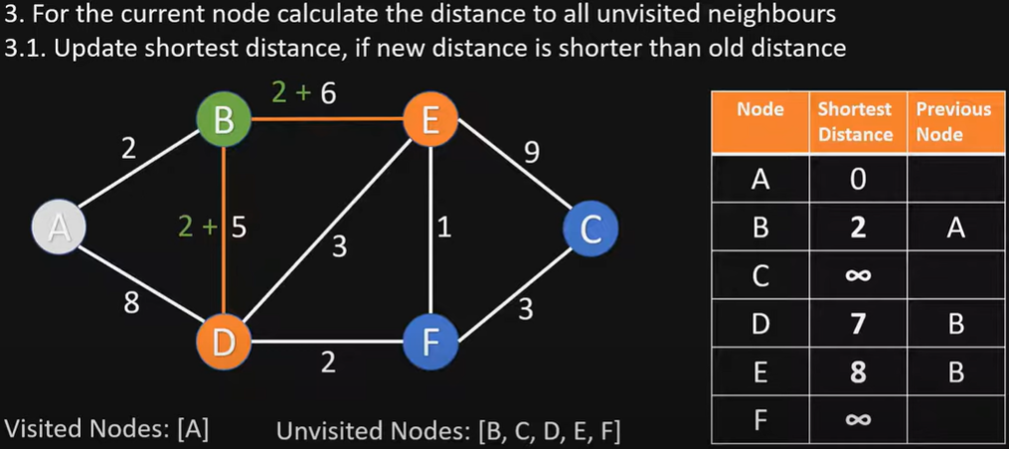
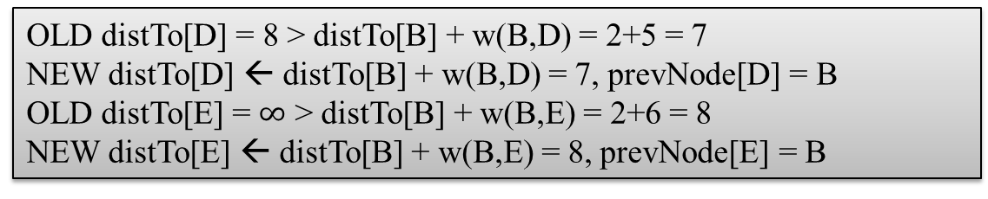
Visit vertex B
OLD distTo[D] = 8 > distTo[B] + w(B,D) = 2+5 = 7
NEW distTo[D] ← distTo[B] + w(B,D) = 7, prevNode[D] = B
OLD distTo[E] = $∞$ > distTo[B] + w(B,E) = 2+6 = 8
NEW distTo[E] ← distTo[B] + w(B,E) = 8, prevNode[E] = B

Slide 15
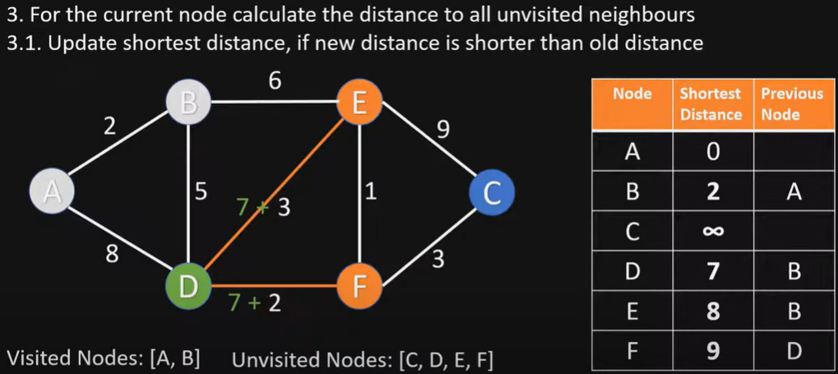
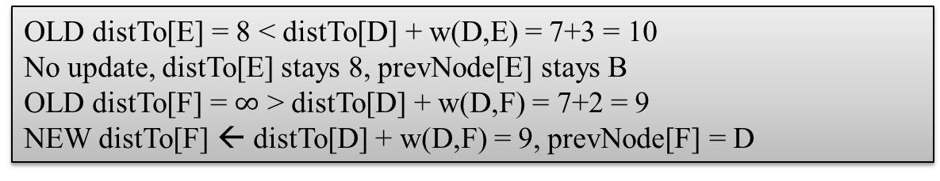
Visit vertex D
OLD distTo[E] = 8 < distTo[D] + w(D,E) = 7+3 = 10
No update, distTo[E] stays 8, prevNode[E] stays B
OLD distTo[F] = $∞$ > distTo[D] + w(D,F) = 7+2 = 9
NEW distTo[F] ← distTo[D] + w(D,F) = 9, prevNode[F] = D

Slide 16
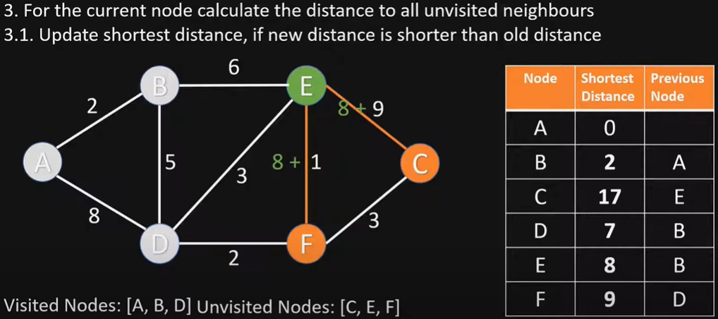
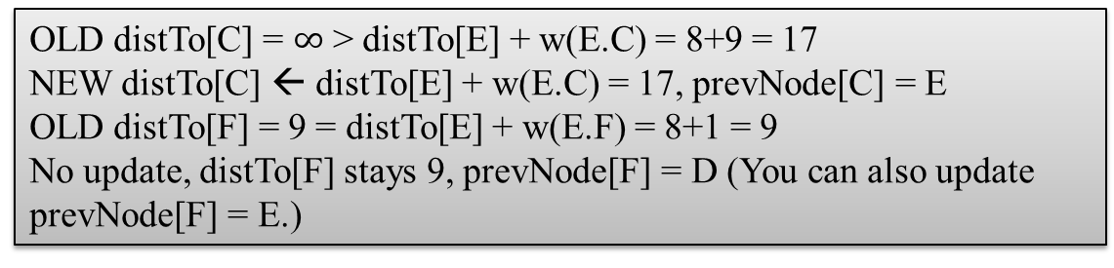
Visit vertex E
OLD distTo[C] = $∞$ > distTo[E] + w(E.C) = 8+9 = 17
NEW distTo[C] ← distTo[E] + w(E.C) = 17, prevNode[C] = E
OLD distTo[F] = 9 = distTo[E] + w(E.F) = 8+1 = 9
No update, distTo[F] stays 9, prevNode[F] = D (You can also update prevNode[F] = E.)

Slide 17
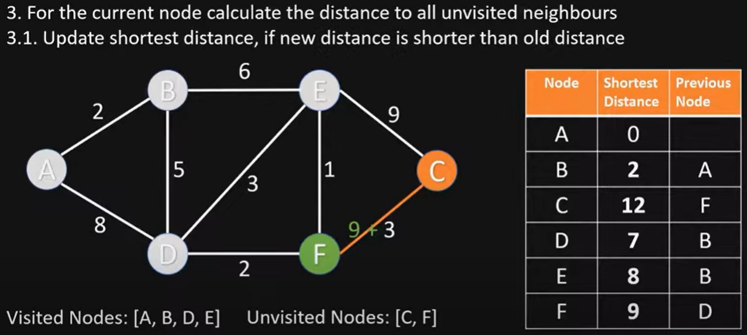
Visit vertex F
OLD distTo[C] = 17 > distTo[F] + w(F,C) = 9+3 = 12
NEW distTo[C] ← distTo[F] + w(F,C) = 12, prevNode[C] = F

Slide 18
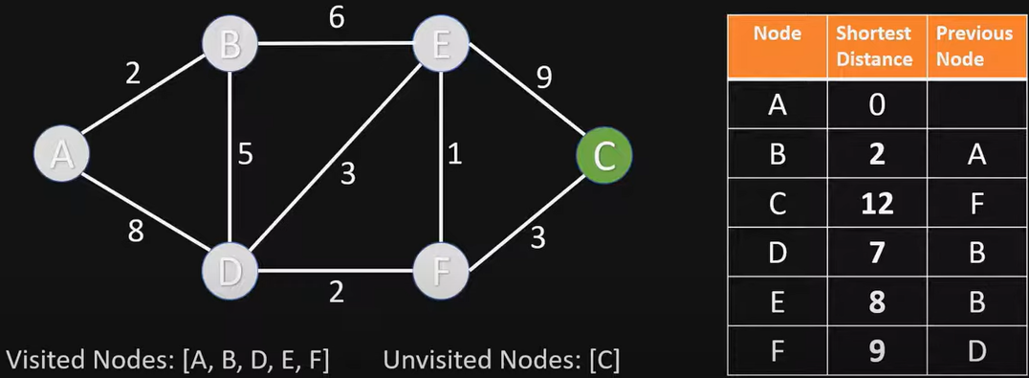
Visit vertex C
Nothing changes, since C has no unvisited neighbor vertices

Slide 19
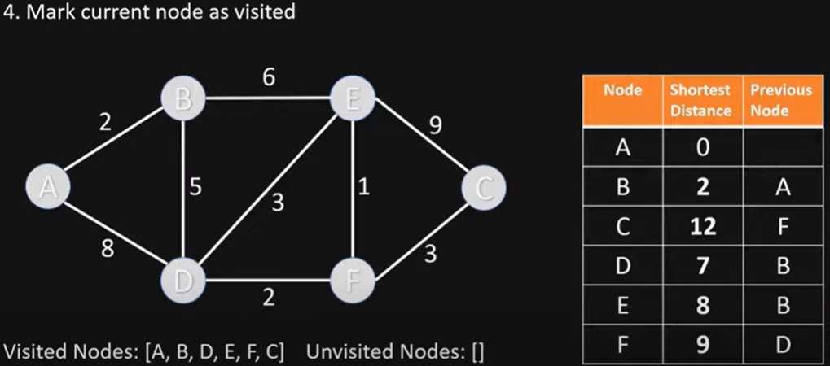
End of Algorithm
Table contains the shortest distance to each vertex N from the source vertex A, and its previous vertex in the shortest path

Slide 20
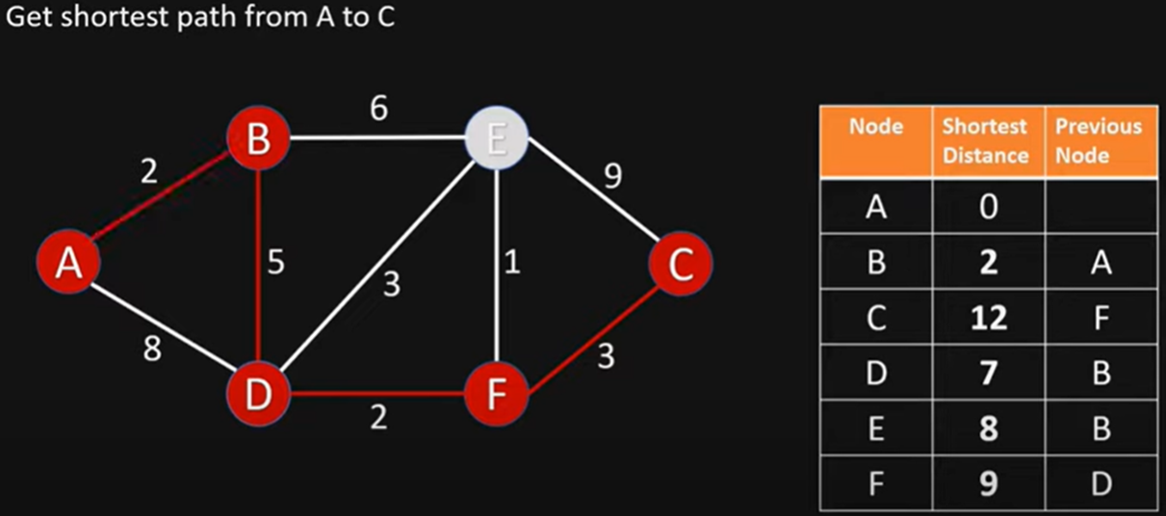
Getting the Shortest Path from A to C
C’s previous vertex is F; F’s previous vertex is D; D’s previous vertex is B; B’s previous vertex is A
Shortest Path from A to C is ABDFC

Slide 21
Dijkstra’s Algorithm Example 2
3
B
D
3
1
A
1
2
1
C
E
4
Notes:
David Kauchak
cs161
Summer 2009
Graphs: MSTs and Shortest Paths https://cs.pomona.edu/~dkauchak/classes/algorithms/

Slide 22
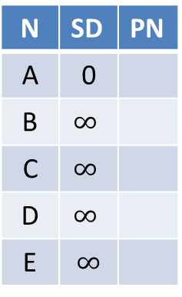
Initialize
∞
∞
3
N | SD | PN
A | 0
B | $$∞$$
C | $$∞$$
D | $$∞$$
E | $$∞$$
B
D
3
0
1
A
1
2
∞
1
C
E
∞
4

Slide 23
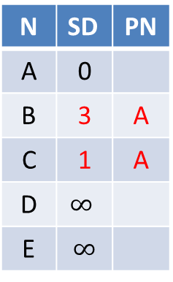
Visit vertex A
3
∞
3
N | SD | PN
A | 0
B | 3 | A
C | 1 | A
D | $$∞$$
E | $$∞$$
B
D
3
0
1
A
1
2
1
1
C
E
∞
4

Slide 24
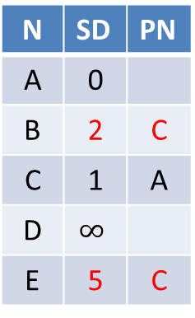
Visit vertex C
2
∞
3
N | SD | PN
A | 0
B | 2 | C
C | 1 | A
D | $$∞$$
E | 5 | C
B
D
3
0
1
A
1
2
1
1
C
E
5
4

Slide 25
Visit vertex B
2
5
3
N | SD | PN
A | 0
B | 2 | C
C | 1 | A
D | 5 | B
E | 3 | B
B
D
3
0
1
A
1
2
1
1
C
E
3
4

Slide 26
Visit vertex E
2
5
3
B
D
N | SD | PN
A | 0
B | 2 | C
C | 1 | A
D | 5 | B
E | 3 | B
3
0
1
A
1
2
1
1
C
E
3
4
Nothing changes

Slide 27
Visit vertex D
2
5
3
N | SD | PN
A | 0
B | 2 | C
C | 1 | A
D | 5 | B
E | 3 | B
B
D
3
0
1
A
1
2
1
1
C
E
3
4
Nothing changes

Slide 28
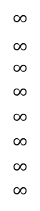
Dijkstra’s Algorithm Example 3
choose vertex 5
relax all edges adjacent from 5
choose vertex 2
relax all edges adjacent from 2
choose vertex 3
relax all edges adjacent from 3
choose vertex 6
relax all edges adjacent from 6
Consider vertices in increasing order of distance from s
(non-tree vertex with the lowest distTo[ ] value).
Add vertex to tree and relax all edges pointing from that vertex.
1
v SD
15
3
$$∞$$
$∞$ $∞$
$$∞$$
$$∞$$
$$∞$$
$$∞$$
$$∞$$
0
5
17
20
9
14
29
8
15
17
13
26
14
25
0
1
2
3
4
5
6
7
5
4
12
0
3
8
7
2
7
9
9
5
6
1
5
11
v PN
4
4
13
6
0
1
2
3
4
5
6
7
-
-
-
-
-
-
-
-
0
1
1
0
7
4
0
7
2
4
5
5
2
20
choose source vertex 0
relax all edges adjacent from 0
choose vertex 1
relax all edges adjacent from 1
choose vertex 7
relax all edges adjacent from 7
choose vertex 4
relax all edges adjacent from 4

Slide 29
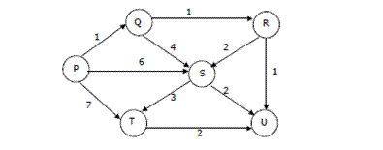
Dijkstra’s Algorithm Example 4
Suppose we run Dijkstra’s single source shortest-path algorithm on the following edge weighted directed graph with vertex P as the source. In what order do the vertices get included into the set of vertices for which the shortest path distances are finalized?
ANS: P, Q, R, U, S, T

Slide 30
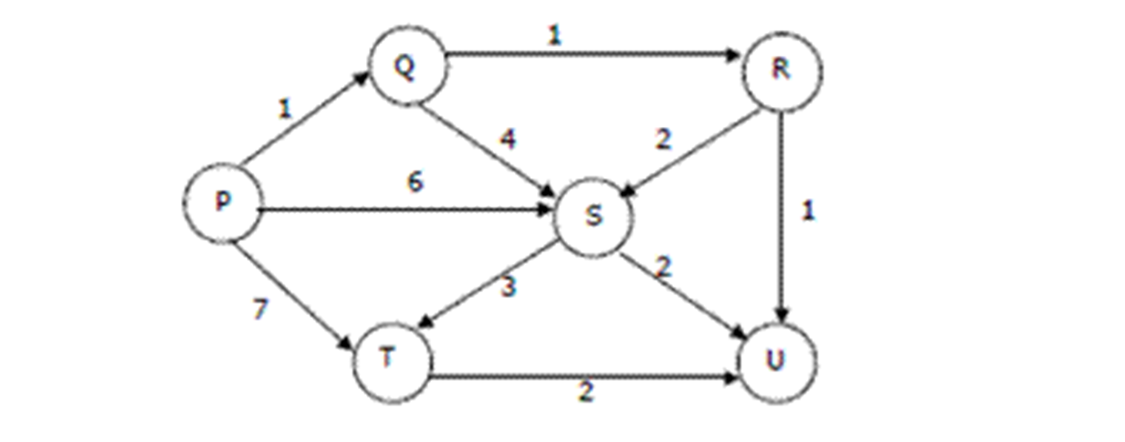
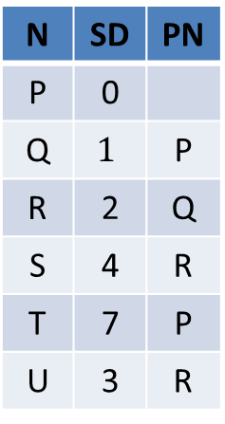
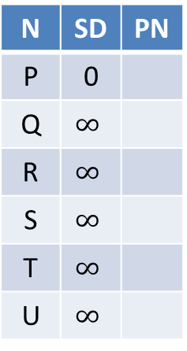
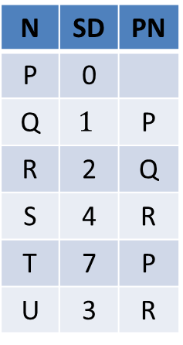
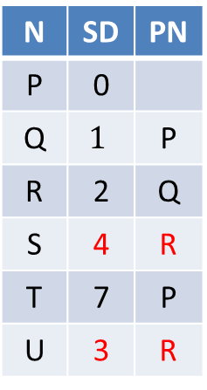
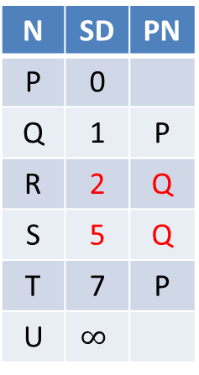
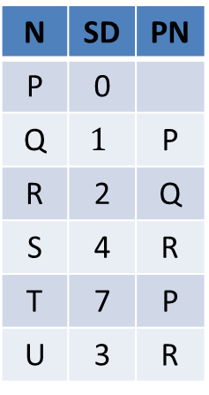
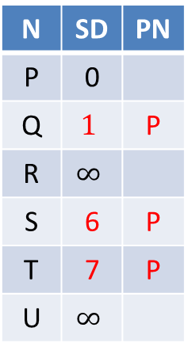

SD: Shortest Distance
PN: Previous vertex
N | SD | PN
P | 0
Q | $$∞$$
R | $$∞$$
S | $$∞$$
T | $$∞$$
U | $$∞$$
N | SD | PN
P | 0
Q | $$1$$ | P
R | $$∞$$
S | 6 | P
T | 7 | P
U | $$∞$$
N | SD | PN
P | 0
Q | 1 | P
R | 2 | Q
S | 5 | Q
T | 7 | P
U | $$∞$$
N | SD | PN
P | 0
Q | $$1$$ | P
R | 2 | Q
S | 4 | R
T | 7 | P
U | 3 | R
Visit P
Visit Q
Visit R
Visit U (nothing changes)
N | SD | PN
P | 0
Q | $$1$$ | P
R | 2 | Q
S | 4 | R
T | 7 | P
U | 3 | R
N | SD | PN
P | 0
Q | $$1$$ | P
R | 2 | Q
S | 4 | R
T | 7 | P
U | 3 | R
N | SD | PN
P | 0
Q | $$1$$ | P
R | 2 | Q
S | 4 | R
T | 7 | P
U | 3 | R
N | SD | PN
P | 0
Q | $$1$$ | P
R | 2 | Q
S | 4 | R
T | 7 | P
U | 3 | R
Visit S
Visit T
Finished
(nothing
changes)
(nothing
changes)

Slide 31
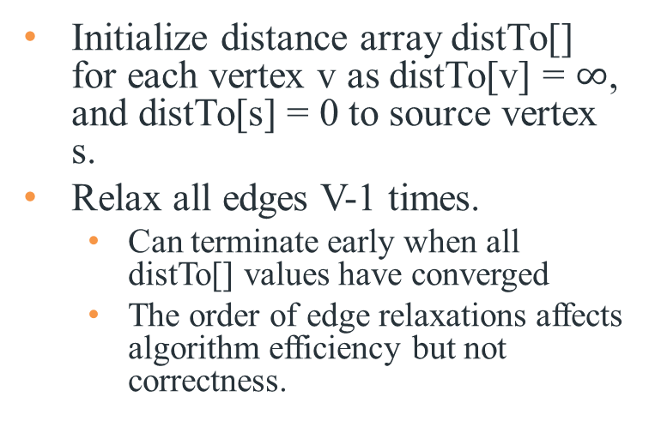
Bellman-Ford Algorithm
Initialize distance array distTo[] for each vertex v as distTo[v] = $∞$, and distTo[s] = 0 to source vertex s.
Relax all edges V-1 times.
Can terminate early when all distTo[] values have converged
The order of edge relaxations affects algorithm efficiency but not correctness.
Recall:
Generic algorithm (to compute SPT from s)
For each vertex v: distTo[v] = ∞.
For each vertex v: edgeTo[v] = null.
distTo[s] = 0.
Repeat until done:
- Relax any edge.
private void relax(DirectedEdge e)
{
Int u = e.from(), v = e.to();
if (distTo[v] > distTo[u] + w(u,v))
{
distTo[v] = distTo[u] + w(u,v);
prevNode[v] = u;
}
}
Bellman–Ford algorithm
For each vertex v: distTo[v] = ∞.
For each vertex v: edgeTo[v] = null.
distTo[s] = 0.
Repeat V-1 times:
- Relax each edge.
Notes:
Now, Relax all the edges one more time i.e. the Nth time and based on the below two cases we can detect the negative cycle:
Case 1 (Negative cycle exists): For any edge(u, v, weight), if dist[u] + weight < dist[v]
Case 2 (No Negative cycle) : case 1 fails for all the edges.
Initialize distance array dist[] for each vertex ‘v‘ as dist[v] = INFINITY.
Assume any vertex (let’s say ‘0’) as source and assign dist = 0.
Relax all the edges(u,v,weight) N-1 times as per the below condition:
dist[v] = minimum(dist[v], dist[u] + weight)
Now, Relax all the edges one more time i.e. the Nth time and based on the below two cases we can detect the negative cycle:
Case 1 (Negative cycle exists): For any edge(u, v, weight), if dist[u] + weight < dist[v]
Case 2 (No Negative cycle) : case 1 fails for all the edges.

Slide 32
Bellman-Ford Algorithm Proof of Correctness
Relaxing edges V-1 times in the Bellman-Ford algorithm guarantees that the algorithm has explored all possible paths with up to V-1 edges, which is the maximum possible number of edges of a shortest path in a graph with V vertices.
This allows the algorithm to correctly calculate the shortest paths from the source vertex to all other vertices, given that there are no negative-weight cycles.

Slide 33
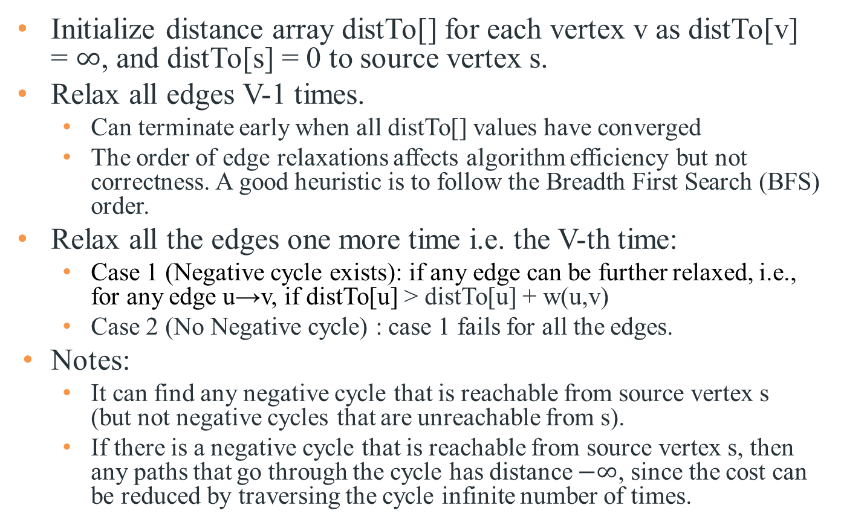
Bellman-Ford Algorithm with Negative Cycle Detection
Initialize distance array distTo[] for each vertex v as distTo[v] = $∞$, and distTo[s] = 0 to source vertex s.
Relax all edges V-1 times.
Can terminate early when all distTo[] values have converged
The order of edge relaxations affects algorithm efficiency but not correctness. A good heuristic is to follow the Breadth First Search (BFS) order.
Relax all the edges one more time i.e. the V-th time:
Case 1 (Negative cycle exists): if any edge can be further relaxed, i.e., for any edge u→v, if distTo[u] > distTo[u] + w(u,v)
Case 2 (No Negative cycle) : case 1 fails for all the edges.
Notes:
It can find any negative cycle that is reachable from source vertex s (but not negative cycles that are unreachable from s).
If there is a negative cycle that is reachable from source vertex s, then any paths that go through the cycle has distance $−∞$, since the cost can be reduced by traversing the cycle infinite number of times.
Notes:
Initialize distance array dist[] for each vertex ‘v‘ as dist[v] = INFINITY.
Assume any vertex (let’s say ‘0’) as source and assign dist = 0.
Relax all the edges(u,v,weight) N-1 times as per the below condition:
dist[v] = minimum(dist[v], dist[u] + weight)
Now, Relax all the edges one more time i.e. the Nth time and based on the below two cases we can detect the negative cycle:
Case 1 (Negative cycle exists): For any edge(u, v, weight), if dist[u] + weight < dist[v]
Case 2 (No Negative cycle) : case 1 fails for all the edges.

Slide 34
Time Complexity of Bellman-Ford Algorithm
Time complexity for connected graph:
Average Case: O(VE)
Worst Case: O(VE)
If the graph is dense or complete, the value of E becomes O(V²). So overall time complexity becomes O(V³)
Notes:
Best Case: O(E), when distance array after 1st and 2nd relaxation are same , we can simply stop further processing after one iteration
What is the time complexity of Bellman-Ford single-source shortest path algorithm on a complete graph of n vertices?
ANS: O(V3)
Time complexity of Bellman-Ford Algorithm Example 1 is O(VE) where V is number of vertices and E is number edges . If the graph is complete, the value of E becomes O(V2). So overall time complexity becomes O(V3)

Slide 35
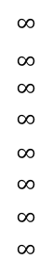
Bellman-Ford Algorithm Example 1
Repeat V − 1 times: relax all E edges.
v distTo[]
0
1
2
3
4
5
6
7
$$∞$$
$∞$ $∞$
$$∞$$
$$∞$$
$$∞$$
$$∞$$
$$∞$$
0
5
17
20
9
13
28
8
14
17
26
25
1
15
3
5
4
12
0
3
8
7
2
7
9
Reverse order of edge relaxations will result in slower convergence
v edgeTo[]
9
5
6
1
0
1
2
3
4
5
6
7
-
-
-
-
-
-
-
-
0
1
1
0
4
2
0
5
2
5
2
5
11
4
4
13
20
6
pass 1
pass 2
pass 3
(converged, no further changes, so stop here)
0→1 0→4 0→7 1→2 1→3 1→7 2→3 2→6 3→6 4→5 4→6 4→7 5→2 5→6 7→2 7→5
Order of edge relaxations

Slide 36
Dijkstra's Algorithm vs. Bellman-Ford Algorithm
Dijkstra's Algorithm:
Uses a priority queue to select the next vertex to process.
Greedily selects the vertex with the smallest tentative distance to source vertex.
Works only on graphs with non-negative edge weights.
Bellman-Ford Algorithm:
Iteratively relaxes all edges V-1 times.
Does not use a priority queue.
Can handle graphs with negative edge weights, and can detect negative cycles.
Dijkstra's algorithm is faster and more efficient for graphs with non-negative weights; Bellman-Ford Algorithm is more versatile as it can handle negative weights and detect negative cycles, albeit at the cost of lower efficiency.
Notes:
Dijkstra's Algorithm:
- Finds the shortest path from a single source vertex to all other vertices in a graph with non-negative edge weights.
**Bellman-Ford Algorithm:**
- Finds the shortest path from a single source vertex to all other vertices in a graph, even with negative edge weights.
- Can detect negative cycles in the graph.
Time complexity of O(V^2) for a dense graph and O(E log V) for a sparse graph.
Time complexity of O(VE), where V is the number of vertices and E is the number of edges in the graph.
, where V is the number of vertices
## Edge Weight Handling
**Dijkstra's Algorithm:**
- Works only on graphs with non-negative edge weights.
**Bellman-Ford Algorithm:**
- Can handle graphs with negative edge weights.
- Can detect negative cycles.
## Performance
Dijkstra's Algorithm:
- More efficient for graphs with non-negative weights.
- Time complexity: O(V log V + E) with a binary heap implementation, where V is the number of vertices and E is the number of edges.
**Bellman-Ford Algorithm:**
- Generally slower than Dijkstra's.
- Time complexity: O(VE), where V is the number of vertices and E is the number of edges.
## Implementation

Slide 37
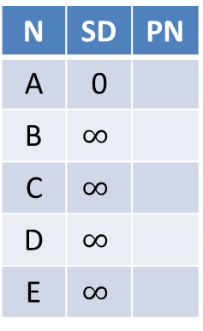
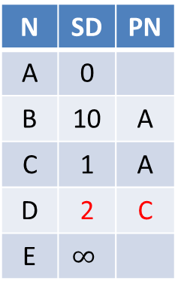
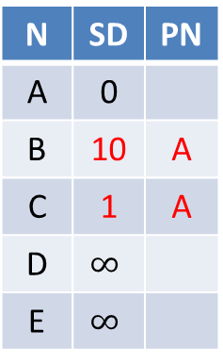
Dijkstra’s Algorithm does not work for Negative Edge Weights
Dijkstra’s Algorithm is greedy and optimal: any vertex that has been visited should have its shortest distance to the source. After visiting A, C, D, we have got D’s shortest distance to A is 2, but after visiting D, D’s distance to A is updated to -10, which violates the greedy optimal assumption of Dijkstra’s Algorithm. Even if you update D’s distance to A to -10, its downstream vertex E’s distance will not be updated.
N | SD | PN
A | 0
B | $$∞$$
C | $$∞$$
D | $$∞$$
E | $$∞$$
N | SD | PN
A | 0
B | 10 | A
C | 1 | A
D | $$∞$$
E | $$∞$$
N | SD | PN
A | 0
B | 10 | A
C | 1 | A
D | 2 | C
E | $$∞$$
N | SD | PN
A | 0
B | 10 | A
C | 1 | A
D | 2 | C
E | 3 | D
Visit A
Visit C
Visit D
N | SD | PN
A | 0
B | 10 | A
C | 1 | A
D | 2 | C
E | 3 | D
N | SD | PN
A | 0
B | 10 | A
C | 1 | A
D | -10 | B
E | 3 | D
Visit E
B
Visit B
10
-20
A
D
1
E
E’s SD is not updated and
Incorrect
1
1
C
Notes:
Run Dijkstra’s algorithm on this graph, starting from vertex A. Run it anyway.
• A → B: 10
• A → C: 1
• B → D: -20
• C → D: 1
Since Dijkstra’s Algorithm is a greedy algorithm, it visits A, C, D, then finishes. I

Slide 38

Bellman Ford Algorithm works for Negative Edge Weights
We run for V-1=3 iterations, then run one more iteration with no change. Hence we conclude that The Bellman-Ford algorithm successfully calculated the shortest paths from vertex A to all other vertices. The shortest path from vertex A to vertex D goes through vertex B with a total cost of -10. There are no negative weight cycles.
Suppose edge update order A→B, A→C, B→D, C→D, D→E
N | SD | PN
A | 0
B | $$∞$$
C | $$∞$$
D | $$∞$$
E | $$∞$$
N | SD | PN
A | 0
B | 10 | A
C | 1 | A
D | -10 | B
E | -9 | D
N | SD | PN
A | 0
B | 10 | A
C | 1 | A
D | -10 | B
E | -9 | D
Iter 1
Iter 2
No change
converged
B
10
-20
A
D
1
E
1
1
C

Slide 39
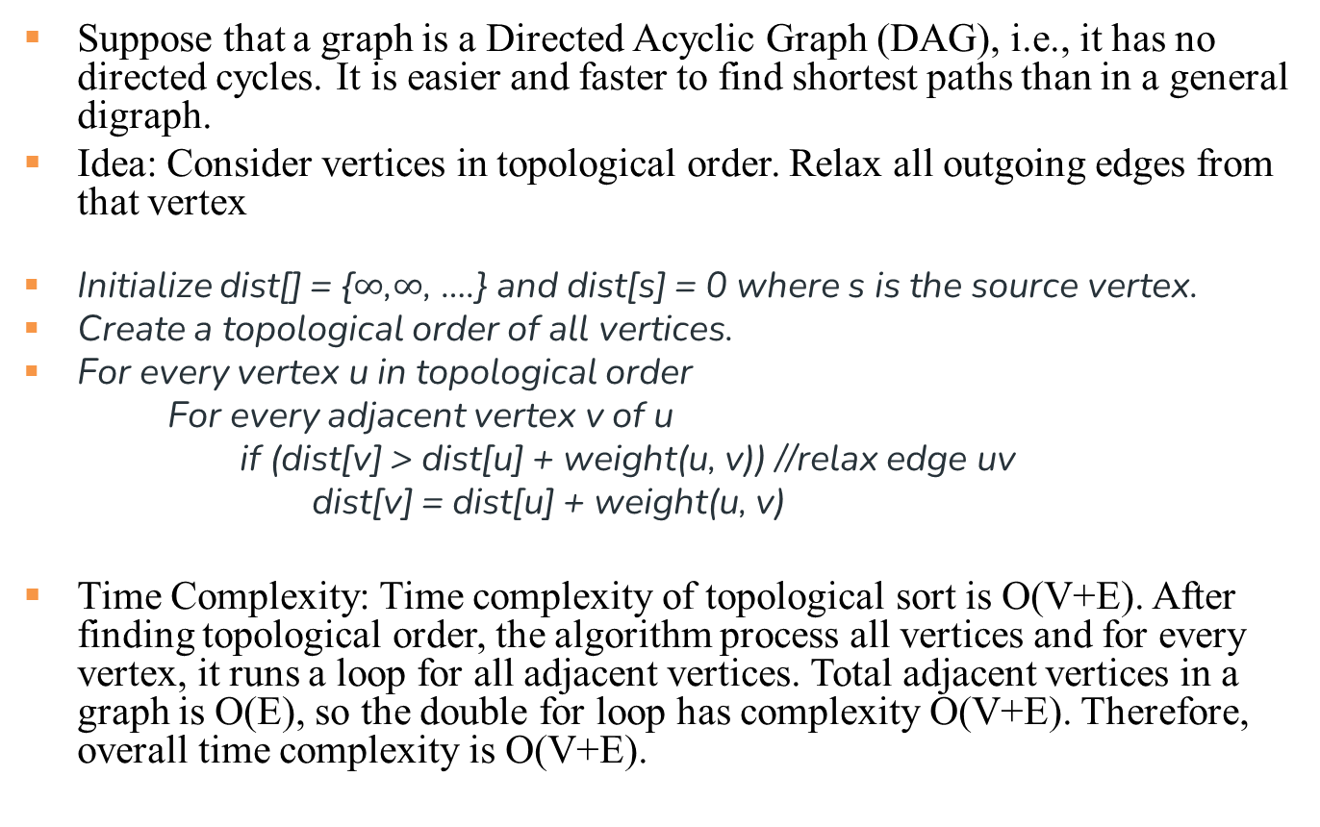
Topological Sort for Shortest Paths in Edge-weighted DAG
Suppose that a graph is a Directed Acyclic Graph (DAG), i.e., it has no directed cycles. It is easier and faster to find shortest paths than in a general digraph.
Idea: Consider vertices in topological order. Relax all outgoing edges from that vertex
Initialize dist[] = {$∞$,$∞$, ….} and dist[s] = 0 where s is the source vertex.
Create a topological order of all vertices.
For every vertex u in topological order
For every adjacent vertex v of u
if (dist[v] > dist[u] + weight(u, v)) //relax edge uv
dist[v] = dist[u] + weight(u, v)
Time Complexity: Time complexity of topological sort is O(V+E). After finding topological order, the algorithm process all vertices and for every vertex, it runs a loop for all adjacent vertices. Total adjacent vertices in a graph is O(E), so the double for loop has complexity O(V+E). Therefore, overall time complexity is O(V+E).

Slide 40
Shortest Paths in Edge-weighted DAG: Correctness Proof
Proposition. Topological sort algorithm computes SPT in any edge- weighted DAG in time proportional to E + V.
edge weights
can be negative!
Pf.
Each edge e = v→w is relaxed exactly once (when v is relaxed),
leaving distTo[w] ≤ distTo[v] + e.weight().
Inequality holds until algorithm terminates because:
distTo[w] cannot increase
distTo[v] will not change
Thus, upon termination, shortest-paths optimality conditions hold.
distTo[ ] values are monotone decreasing
because of topological order, no edge pointing to v will be relaxed after v is relaxed

Slide 41
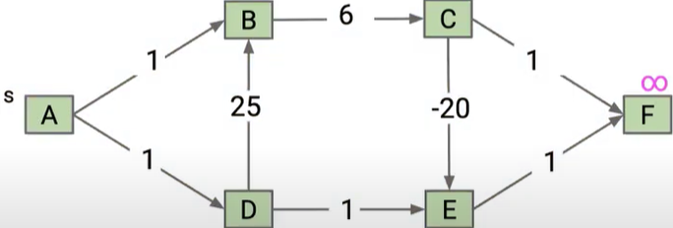
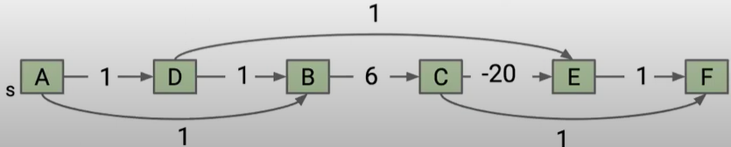
Topological Sort Example 1
Consider this DAG and a topological order ADBCEF

Slide 42
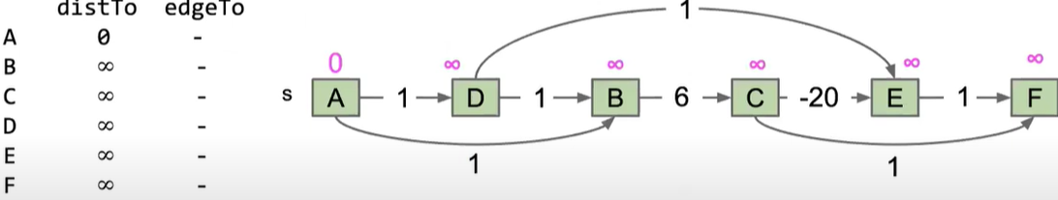
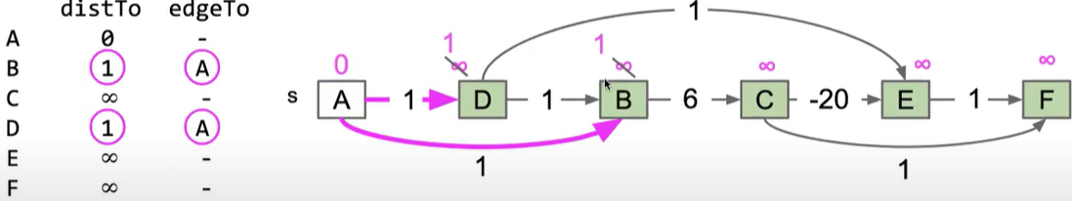
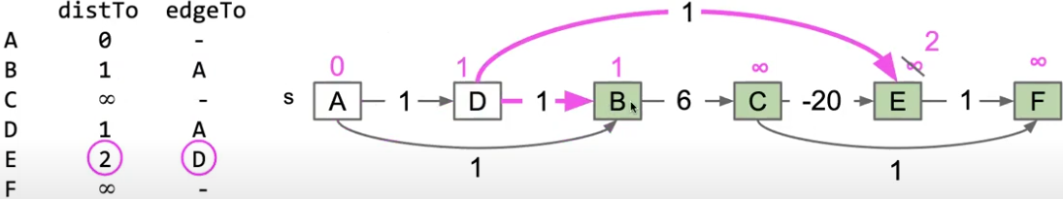
Initialize
Visit A
Visit D

Slide 43
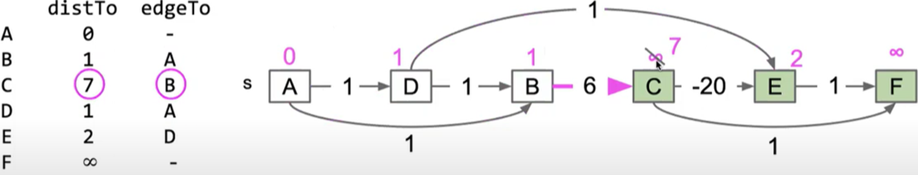
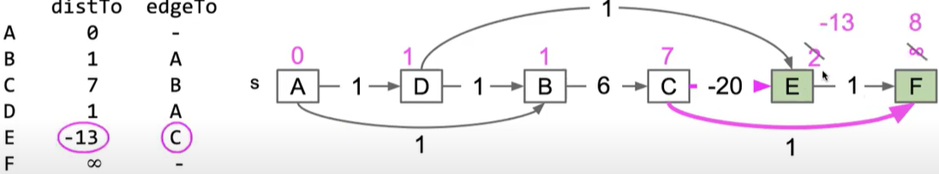
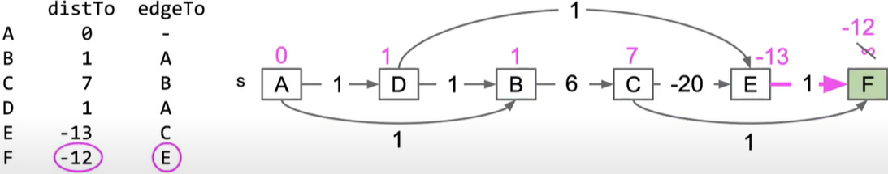
Visit B
Visit C
8
C
C
Visit E

Slide 44
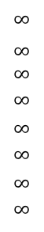
Topological Sort Example 2
Consider this DAG and a topological order 01475236
v distTo[]
0
1
2
3
4
5
6
7
$$∞$$
$∞$ $∞$
$$∞$$
$$∞$$
$$∞$$
$$∞$$
$$∞$$
0
5
17
20
9
13
29
8
15
17
26
14
25
0 1 4 7 5 2 3 6
1
15
3
5
4
12
0
3
v edgeTo[]
8
7
2
0
1
2
3
4
5
6
7
-
-
-
-
-
-
-
-
0
1
1
0
4
4
0
7
2
5
5
2
7
9
9
5
6
1
5
11
4
4
13
20
6

Slide 45
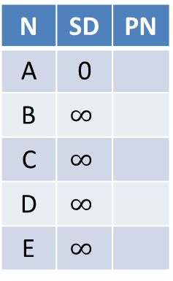
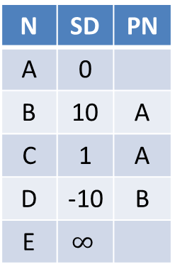


Topological Sort Example 3
N | SD | PN
A | 0
B | $$∞$$
C | $$∞$$
D | $$∞$$
E | $$∞$$
N | SD | PN
A | 0
B | 10 | A
C | 1 | A
D | $$∞$$
E | $$∞$$
N | SD | PN
A | 0
B | 10 | A
C | 1 | A
D | -10 | B
E | $$∞$$
N | SD | PN
A | 0
B | 10 | A
C | 1 | A
D | -10 | B
E | $$∞$$
Visit A
Visit B
Visit C
Visit D
N | SD | PN
A | 0
B | 10 | A
C | 1 | A
D | -10 | B
E | -9 | D
N | SD | PN
A | 0
B | 10 | A
C | 1 | A
D | -10 | B
E | -9 | D
Visit E
B
10
-20
A
D
1
E
1
1
Consider topological order ABCDE
C

Slide 46


Topological Sort Example 3
N | SD | PN
A | 0
B | $$∞$$
C | $$∞$$
D | $$∞$$
E | $$∞$$
N | SD | PN
A | 0
B | 10 | A
C | 1 | A
D | $$∞$$
E | $$∞$$
N | SD | PN
A | 0
B | 10 | A
C | 1 | A
D | 2 | C
E | $$∞$$
N | SD | PN
A | 0
B | 10 | A
C | 1 | A
D | -10 | B
E | $$∞$$
Visit A
Visit C
Visit B
Visit D
N | SD | PN
A | 0
B | 10 | A
C | 1 | A
D | -10 | B
E | -9 | D
N | SD | PN
A | 0
B | 10 | A
C | 1 | A
D | -10 | B
E | -9 | D
Visit E
B
10
-20
A
D
1
E
1
1
Consider topological order ACBDE
C

Slide 47

Longest Paths in Edge-weighted DAG
Formulate as a shortest paths problem in edge-weighted DAGs.
Negate all weights.
Find shortest paths.
Negate weights in result.
equivalent: reverse sense of equality in relax()
longest paths input
shortest paths input
5->4 | 0.35 | 5->4 | -0.35
4->7 | 0.37 | 4->7 | -0.37
5->7 | 0.28 | 5->7 | -0.28
5->1 | 0.32 | 5->1 | -0.32
4->0 | 0.38 | 4->0 | -0.38
0->2 | 0.26 | 0->2 | -0.26
3->7 | 0.39 | 3->7 | -0.39
1->3 | 0.29 | 1->3 | -0.29
7->2 | 0.34 | 7->2 | -0.34
6->2 | 0.40 | 6->2 | -0.40
3->6 | 0.52 | 3->6 | -0.52
6->0 | 0.58 | 6->0 | -0.58
6->4 | 0.93 | 6->4 | -0.93
s
Topological sort algorithm for DAGs works even with negative weights.
For general graphs, the longest paths problem is an unsolved problem (exponential time at best)

Slide 48
Single Source Shortest-paths Algorithms Summary
Algorithm | Restriction | Worst-Case Complexity
Dijkstra (Fibonacci heap) | Undirected or directed graph; no negative weights/cycles | O(V log V + E)
Bellman-Ford | Directed graph with negative weights; undirected graph with no negative weights (since a negative weight edge forms a negative cycle by itself) | O(EV)
Topological Sort | Directed Acyclic Graph (DAG) (directed graph, no cycles) | O(E+V)
Notes:
typical case
worst case O(VlogV+E)
Remark 1. Directed cycles make the problem harder.
Remark 2. Negative weights make the problem harder.
Remark 3. Negative cycles makes the problem ill-defined.
E+V
E+V
Dijkstra (binary heap)
E log V
E log V
Bellman-Ford
EV
EV

Slide 49
Floyd Warshall Algorithm for all-pairs shortest paths
The Floyd Warshall Algorithm is an all pair shortest path algorithm unlike Dijkstra and Bellman Ford which are single source shortest path algorithms.
It works for both the directed and undirected weighted graphs. But, it does not work for the graphs with negative cycles
It follows Dynamic Programming approach to check every possible path going via every possible vertex in order to calculate shortest distance between every pair of vertices.
For k = 0 to n – 1 For i = 0 to n – 1 For j = 0 to n – 1 dist[i, j] = min(dist[i, j], dist[i, k] + dist[k, j])
// Update dist[i, j] if shortcut through vertex k has shorter path
where i = source vertex, j = Destination vertex, k = Intermediate vertex
Time Complexity: O(V³), where V is the number of vertices in the graph and we run three nested loops each of size V

Slide 50

Floyd Warshall Algorithm is Dynamic Programming
Floyd Warshall Algorithm is a Dynamic Programming based algorithm. It finds all pairs shortest paths using following recursive nature of problem. For every pair (i, j) of source and destination vertices respectively, there are two possible cases. 1) k is not an intermediate vertex in shortest path from i to j. We keep the value of dist[i][j] as it is. 2) k is an intermediate vertex in shortest path from i to j. We update the value of dist[i][j] as dist[i][k] + dist[k][j]. The following figure shows the above optimal substructure property in the all-pairs shortest path problem, which enables the use of dynamic programming.

Slide 51

Floyd Warshall Algorithm Example

Slide 52



Step 1: Initialize the dist[][] matrix using the input graph such that dist[i][j]= weight of edge from i to j, also dist[i][j] = $∞$ if there is no edge from i to j.
 | A | B | C | D | E
A | 0 | 4 | $$∞$$ | 5 | $$∞$$
B | $$∞$$ | 0 | 1 | $$∞$$ | 6
C | 2 | $$∞$$ | 0 | 3 | $$∞$$
D | $$∞$$ | $$∞$$ | 1 | 0 | 2
E | 1 | $$∞$$ | $$∞$$ | 4 | 0

Slide 53



Step 2: Treat vertex A as an intermediate vertex and calculate the dist[][] for every {i,j} vertex pair using the formula:
dist[i][j] = min(dist[i][j], dist[i][A] + dist[A][j])
 | A | B | C | D | E
A | 0 | 4 | $$∞$$ | 5 | $$∞$$
B | $$∞$$ | 0 | 1 | $$∞$$ | 6
C | 2 | $$∞$$ | 0 | 3 | $$∞$$
D | $$∞$$ | $$∞$$ | 1 | 0 | 2
E | 1 | $$∞$$ | $$∞$$ | 4 | 0
 | A | B | C | D | E
A | 0 | 4 | $$∞$$ | 5 | $$∞$$
B | $$∞$$ | 0 | 1 | $$∞$$ | 6
C | 2 | $$6$$ | 0 | 3 | $$∞$$
D | $$∞$$ | $$∞$$ | 1 | 0 | 2
E | 1 | 5 | $$∞$$ | 4 | 0

Slide 54



Step 3: Treat vertex B as an intermediate vertex and calculate the dist[][] for every {i,j} vertex pair using the formula: dist[i][j] = minimum (dist[i][j], dist[i][B] + dist[B][j])
 | A | B | C | D | E
A | 0 | 4 | $$∞$$ | 5 | $$∞$$
B | $$∞$$ | 0 | 1 | $$∞$$ | 6
C | 2 | $$6$$ | 0 | 3 | $$∞$$
D | $$∞$$ | $$∞$$ | 1 | 0 | 2
E | 1 | 5 | $$∞$$ | 4 | 0
 | A | B | C | D | E
A | 0 | 4 | 5 | 5 | 10
B | $$∞$$ | 0 | 1 | $$∞$$ | 6
C | 2 | $$6$$ | 0 | 3 | 12
D | $$∞$$ | $$∞$$ | 1 | 0 | 2
E | 1 | 5 | 6 | 4 | 0

Slide 55



Step 4: Treat vertex C as an intermediate vertex and calculate the dist[][] for every {i,j} vertex pair using the formula: dist[i][j] = minimum (dist[i][j], dist[i][C] + dist[C][j])
 | A | B | C | D | E
A | 0 | 4 | 5 | 5 | 10
B | $$∞$$ | 0 | 1 | $$∞$$ | 6
C | 2 | $$6$$ | 0 | 3 | 12
D | $$∞$$ | $$∞$$ | 1 | 0 | 2
E | 1 | 5 | 6 | 4 | 0
 | A | B | C | D | E
A | 0 | 4 | 5 | 5 | 10
B | 3 | 0 | 1 | 4 | 6
C | 2 | $$6$$ | 0 | 3 | 12
D | 3 | 7 | 1 | 0 | 2
E | 1 | 5 | 6 | 4 | 0

Slide 56



Step 5: Treat vertex D as an intermediate vertex and calculate the dist[][] for every {i,j} vertex pair using the formula: dist[i][j] = minimum (dist[i][j], dist[i][D] + dist[D][j])
 | A | B | C | D | E
A | 0 | 4 | 5 | 5 | 10
B | 3 | 0 | 1 | 4 | 6
C | 2 | $$6$$ | 0 | 3 | 12
D | 3 | 7 | 1 | 0 | 2
E | 1 | 5 | 6 | 4 | 0
 | A | B | C | D | E
A | 0 | 4 | 5 | 5 | 7
B | 3 | 0 | 1 | 4 | 6
C | 2 | $$6$$ | 0 | 3 | 5
D | 3 | 7 | 1 | 0 | 2
E | 1 | 5 | 5 | 4 | 0

Slide 57



Step 6: Treat vertex E as an intermediate vertex and calculate the dist[][] for every {i,j} vertex pair using the formula: dist[i][j] = minimum (dist[i][j], dist[i][E] + dist[E][j])
 | A | B | C | D | E
A | 0 | 4 | 5 | 5 | 7
B | 3 | 0 | 1 | 4 | 6
C | 2 | $$6$$ | 0 | 3 | 5
D | 3 | 7 | 1 | 0 | 2
E | 1 | 5 | 5 | 4 | 0
 | A | B | C | D | E
A | 0 | 4 | 5 | 5 | 7
B | 3 | 0 | 1 | 4 | 6
C | 2 | $$6$$ | 0 | 3 | 5
D | 3 | 7 | 1 | 0 | 2
E | 1 | 5 | 5 | 4 | 0

Slide 58

Step 7: Since all the vertices have been treated as an intermediate vertex, we can now return the updated dist[][] matrix as our answer matrix.

Slide 59
Johnson’s Algorithm for all-pairs shortest paths
Idea: run Dijkstra’s Single Source shortest path algorithm with every vertex as the source.
Dijkstra’s algorithm doesn’t work for negative weight edge. The idea of Johnson’s algorithm is to reweight all edges and make them all positive, then run Dijkstra’s algorithm with every vertex as the source.
We can run Bellman-Ford algorithm with every vertex as the source without reweighting, since Bellman-Ford algorithm can handle negative edge weights, but the time complexity is much higher than running Dijkstra’s algorithm.
How to transform a given graph into a graph with non-negative weight edges without changing the shortest paths?

Slide 60
Example 1: Increase weight of every edge by a constant?
True or False: In a weighted graph, assume that the shortest path from source s to destination t is correctly calculated using a shortest path algorithm. If we increase weight of every edge by a constant, the shortest path always remains same.
False. See the following counterexample. There are 4 edges sa, ab, bt and st with weights 1, 1, 1 and 4 respectively. The shortest path from s to t is sabt with cost 3. If we increase weight of every edge by 1, the shortest path changes to st with cost 5.
Similarly for negative weight edges. There are 4 edges sa, ab, bt and st with weights -1, -1, -1 and -2 respectively. The shortest path from s to t is sabt with cost -3. If we increase weight of every edge by 1, the shortest path changes to st with cost -1.
s
1
a
1
b
1
t
2
2
2
s
a
b
t
4
5
s
- 1
a
- 1
b
- 1
t
s
0
a
0
b
0
t
-2
-1
Notes:
1 1
s-----a-----b-----t
\ /
\ /
\ __4 __/

Slide 61
Double the original weights?
True or False: Is the following statement valid about shortest paths? Given a graph, suppose we have calculated shortest path from a source to all other vertices. If we modify the graph such that weights of all edges becomes double of the original weight, then the shortest path remains same, and only the total weight of path changes.
True. The shortest path remains same. It is like if we change unit of distance from meter to kilo meter, the shortest paths do not change. But this does not make weights positive.

Slide 62
Johnson’s algorithm for All-pairs Shortest Paths
Let the given graph be G. Add a dummy source vertex d, and add edges with weight 0 from d to all vertices of G. Let the modified graph be G’.
Run Bellman-Ford algorithm on G’ with d as the source. Let the shortest distances calculated by Bellman-Ford be h[0], h[1], .. h[V-1]. If we find a negative weight cycle, then return. (We run Bellman-Ford algorithm since it can handle negative edge weights.)
Reweight the edges of the original graph. For each edge (u, v), assign the new weight as w'(u, v) = w(u, v) + h[u] – h[v], which is greater than or equal to 0.
Remove the added dummy vertex d, and run Dijkstra’s algorithm with every vertex as the source to obtain all-pairs shortest paths. Subtract h[u] – h[v] from length of each shortest path to obtain the lengths of shortest paths in the original graph.
Time complexity: Johnson’s algorithm uses both Dijkstra and Bellman-Ford as subroutines. The main steps in the algorithm are Bellman-Ford Algorithm called once and Dijkstra called V times. Time complexity of Bellman Ford is O(VE) and time complexity of Dijkstra is O(V log V + E). So overall time complexity is O(V² log V + VE).
Notes:
Note that the negative weight cycle cannot be created by new vertex s as there is no edge to s. All edges are from s.
After adding a dummy source vertex d and edge reweighting, all edge weights are greater than or equal to 0, so we can run Dijkstra’s shortest path algorithm with every vertex as the source.

Slide 63
Johnson’s Algorithm: Proof
The following property is always true since h[] values are the shortest distances from the dummy source code d:
h[v] <= h[u] + w(u, v)
The property states that the shortest distance from u to v must be smaller than or equal to the shortest distance from s to u plus edge weight w(u, v). Because of this inequality, the new weights w’(u, v) = w(u, v) + h[u] – h[v] must be greater than or equal to 0.
After reweighting, and all weights become non-negative, and all set of paths between any two vertices s and t is increased by the same amount, hence the shortest paths remain the same as the original graph before reweighting.
Consider any path between two vertices s and t, the weight of every path is increased by h[s] – h[t], since the added h[] values for all intermediate vertices on the path from s to t cancel each other out.
d
h(u)
h(v)
u
w(u,v)
v
Notes:
We add a source s and add edges from s to all vertices of the original graph. In the following diagram s is 4.

Slide 64



Johnson’s Algorithm Example 2
We add a dummy source vertex d and add edges with weight 0 from s to all vertices of the original graph.
We run Bellman-Ford algorithm to calculate the shortest distances from d to all other vertices. The shortest distances from d to 0, 1, 2 and 3 are
h[0]=0 (path d→0), h[1]=-5 (path d→0→1), h[2]=-1 (path d→0→1→2), h[3]=0 (path d→3)
Once we get these distances, we remove vertex d and reweight each edge uv as: w'(u, v) = w(u, v) + h[u] – h[v].
w’(0,1)=0, w’(1,2)=0, w’(2,3)=0, w’(0,3)=3, w’(0,2)=3
Since all weights are greater than or equal to 0 now, we can run Dijkstra’s shortest path algorithm with every vertex as the source.
h[0]=0
h[1]=-5
d
h[3]=0
h[2]=-1

Slide 65
Johnson’s Algorithm Example 2 Con’t
Let’s run Dijkstra’s shortest path algorithm with vertex 0 as the source. We can obtain the shortest paths shown on the left
We then subtract h[u] – h[v] from length of each shortest path from u to v to obtain the lengths of shortest paths in the original graph shown on the right, e.g., SD(0→2)=0-(h[0]-h[2])=0-(0-(-1))=-1)
N | SD’ | PN
0 | 0
1 | 0 | 0
2 | 0 | 1
3 | 0 | 2
N | SD | PN
0 | 0
1 | -5 | 0
2 | -1 | 1
3 | 0 | 2
Shortest paths from 0 in modified graph
Shortest paths from 0 in original graph

Slide 66
Johnson’s Algorithm: Example 1 Revisited
w’(s, a) = w(s, a) + h[s] – h[a] = -1 + 0 - (-1) = 0
w’(a, b) = w(a, b) + h[a] – h[b] = -1 + -1 - (-2) = 0
w’(b, t) = w(b, t) + h[b] – h[t] = -1 + -2 - (-3) = 0
w’(s, t) = w(s, t) + h[s] – h[t] = -2 + 0 - (-3) = 1
w’(s, a) + w’(a, b) + w’(b, t) = w(s, a) + w(a, b) + w(b, t) + h[s] – h[t] = -1 -1 -1 + 0 – (-3) = 0
w’(s, t) = w(s, t) + h[s] – h[t] = -2 + 0 – (-3) = 1
For example, the shortest path from s to t is sabt, same as the original graph before reweighting. Its length in the original graph is 0 – (h[s] – h[t]) = 0 – (0 – (-3)) = -3.
d
0
0
0
-1 + -1 - (-2) = 0
0
-1 + -2 - (-3) = 0
-1 + 0 - (-1) = 0
s
- 1
a
- 1
b
- 1
t
s
a
b
t
H[s]=0
H[a]=-1
H[b]=-2
H[t]=-3
-2
-2 + 0 - (-3) = 1
N | SD’ | PN
s | 0
a | 0 | s
b | 0 | a
t | 0 | b
N | SD | PN
s | 0
a | -1 | s
b | -2 | a
t | -3 | b
Shortest paths from s in modified graph (right)
Shortest paths from s in original graph (left)

Slide 67
Video Tutorials
Dijkstras Shortest Path Algorithm Explained | With Example | Graph Theory
https://www.youtube.com/watch?v=bZkzH5x0SKU
The following lecture slides are based on this video
Dijkstra's algorithm in 3 minutes
https://www.youtube.com/watch?v=_lHSawdgXpI
Bellman-Ford in 4 minutes — Theory
https://www.youtube.com/watch?v=9PHkk0UavIM
Bellman-Ford in 5 minutes — Step by step example
https://www.youtube.com/watch?v=obWXjtg0L64
Shortest Path Algorithms Explained (Dijkstra's & Bellman-Ford https://www.youtube.com/watch?v=AE5I0xACpZs
Floyd–Warshall algorithm in 4 minutes
https://www.youtube.com/watch?v=4OQeCuLYj-4
Notes:
Dijkstras Shortest Path Algorithm Explained | With Example | Graph Theory
https://www.youtube.com/watch?v=bZkzH5x0SKU
Dijkstra's algorithm in 3 minutes
https://www.youtube.com/watch?v=_lHSawdgXpI
Bellman-Ford in 4 minutes — Theory
https://www.youtube.com/watch?v=9PHkk0UavIM
Bellman-Ford in 5 minutes — Step by step example
https://www.youtube.com/watch?v=obWXjtg0L64

Slide 68
Tutorials from Geeksforgeeks
https://www.geeksforgeeks.org/introduction-to-dijkstras-shortest-path-algorithm/
https://www.geeksforgeeks.org/bellman-ford-algorithm-dp-23/
https://www.geeksforgeeks.org/floyd-warshall-algorithm-dp-16/
https://www.geeksforgeeks.org/johnsons-algorithm/

Slide 69
Quiz
Which of the following algorithm can be used to efficiently calculate single source shortest paths in a Directed Acyclic Graph?
Dijkstra
Bellman-Ford
Topological Sort
ANS: Topological Sort
Topological Sort has complexity O(V+E), which is the most efficient algorithm among the three
Notes:
Given an unweighted graph where weight of every edge is 1, we can most efficiently find shortest path from a given source to destination using?
A. Breadth First Traversal
B. Dijkstra's Shortest Path Algorithm
C. Neither Breadth First Traversal nor Dijkstra\'s algorithm can be used
D. Depth First Search
ANS: A
With BFS, we first explore vertices at one edge distance, then all vertices at 2 edge distance, and so on.

Slide 70
Quiz
Given a graph where all edges have positive weights, the shortest paths produced by Dijsktra and Bellman Ford algorithm may be different but path weight would always be same.
ANS: True
Dijkstra and Bellman-Ford both work fine for a graph with all positive weights, but they are different algorithms and may pick different edges for shortest paths.

Slide 71
Quiz
Match the following
Group A
a) Dijkstra's single shortest path algo
b) Bellmen Ford's single shortest path algo
c) Floyd Warshall's all pair shortest path algo
Group B
p) Dynamic Programming
q) Backtracking
r) Greedy Algorithm
Dijkstra is a greedy algorithm where we pick the minimum distant vertex from not yet finalized vertices. Bellman Ford and Floyd Warshall both are Dynamic Programming algorithms where we build the shortest paths in bottom up manner.

Slide 72
Quiz
Let G be a directed graph whose vertex set is the set of numbers from 1 to 100. There is an edge from a vertex i to a vertex j if either j = i + 1 or j = 3i. The minimum number of edges in a path in G from vertex 1 to vertex 100 is
A. 4 B. 7 C. 23 D. 99
ANS: 7
The task is to find minimum number of edges in a path in G from vertex 1 to vertex 100 such that we can move to either i+1 or 3i from a vertex i.
Since the task is to minimize number of edges, we would prefer to follow 3*i. Let us follow multiple of 3. 1 => 3 => 9 => 27 => 81, now we can't follow multiple of 3 anymore. So we will have to follow i+1. This solution gives a long path.
What if we begin from end, and we reduce by 1 if the value is not multiple of 3, else we divide by 3. 100 => 99 => 33 => 11 => 10 => 9 => 3 => 1
So we need total 7 edges.

